Slide 1

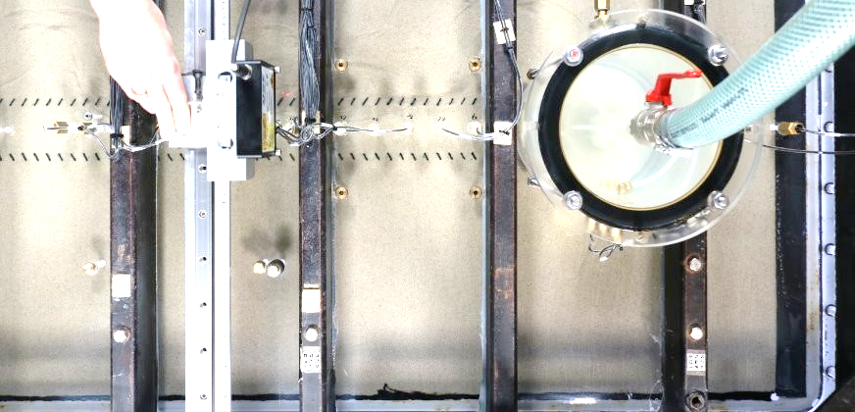



Real-time Data Integration and Analysis in Backward Erosion Piping Experiments Using a Digital Twin
Diana Portillo Arreguin, Lisa van der Linde,
Marc Fransen, Vera van Beek.
11 november 2025 - Amersfoort

Slide 2
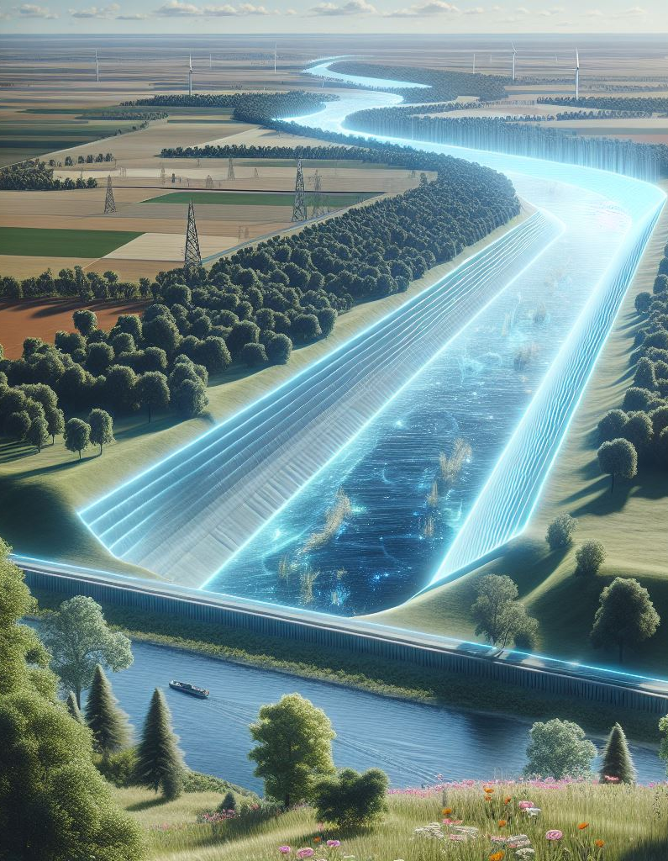
What is a Digital Twin?
Introduction
BEP Experiment
Digital Twin Implementation
Dashboards and Results
Conclusions
Virtual representation of a physical system, updated in real-time with data from sensors, simulations, or experiments.
Allows to analyse, predict, and optimize performance without directly interacting with the system.
Think of it as mirror of an experiment.
Notes:
A digital twin is a virtual representation of a physical system, updated in real-time with data from sensors, simulations, or experiments.
It allows to analyse, predict, and optimize performance without directly interacting with the physical system.
Think of it as a high-tech mirror of an experiment, but one that can also simulate different conditions and predict outcomes.

Slide 3
Advantages of a Digital Twin
Introduction
BEP Experiment
Digital Twin Implementation
Dashboards and Results
Conclusions
Real-time
Better understanding and visualisation
Scenario testing without modifying the actual set up
Improved decision making
Data integration from multiple sources
Notes:
Real-time Monitoring – Tracks experiment parameters dynamically.
Better Understanding – Visualizes data in an intuitive way (e.g., interactive plots).
Scenario Testing – Simulates changes without modifying the actual setup (geometries, properties, etc).
Improved Decision-Making – Helps identify trends, anomalies, and optimizations while the experiment is ongoing.
Data Integration – Combines multiple data sources for deeper insights.

Slide 4
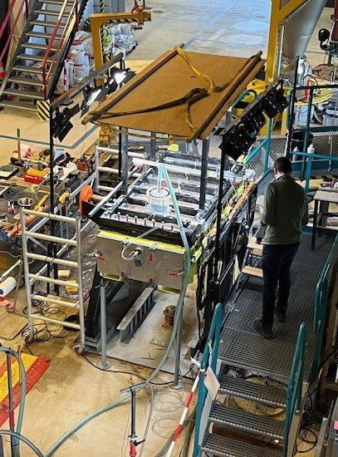
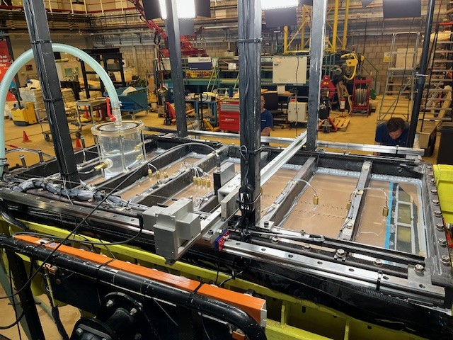
BEP medium scale experiment
Introduction
BEP Experiment
Digital Twin Implementation
Dashboards and Results
Conclusions
Set up
Notes:
The experiment aims to study piping erosion, a process where water flow gradually removes soil particles, potentially leading to structural failure.
The setup consists of a box filled with sand, instrumented with pore pressure sensors.
Water enters through an inflow, and exits at a central outflow, forcing the development of a pipe (erosion channel) around the center of the box.
The rate and amount of outflowing water are monitored using collection buckets.

Slide 5
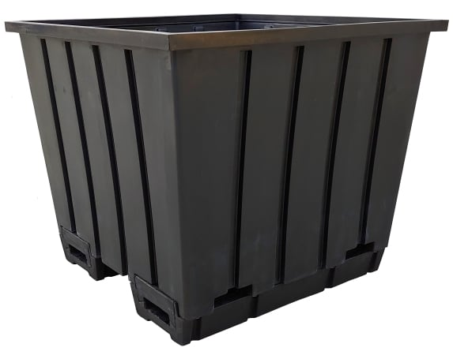


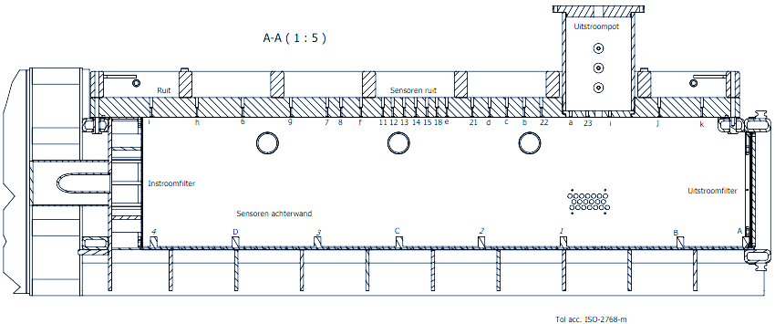
BEP medium scale experiment
Introduction
BEP Experiment
Digital Twin Implementation
Dashboards and Results
Conclusions
Instrumentation
Outflow
32 PPT
Inflow
Outflow
Fine sand
Notes:
The experiment aims to study piping erosion, a process where water flow gradually removes soil particles, potentially leading to structural failure.
The setup consists of a box filled with sand, instrumented with pore pressure sensors.
Water enters through an inflow, and exits at a central outflow, forcing the development of a pipe (erosion channel) around the center of the box.
The rate and amount of outflowing water are monitored using collection buckets.

Slide 6
Digital Twin Implementation
Introduction
BEP Experiment
Digital Twin Implementation
Dashboards and Results
Conclusions
Uncertainties during experiments
How close are critical conditions?
Post-processing
Uncertainties are solved
Digital Twin
Real-time insights
Improve decision-making during the experiment
How are pressures distributed?
Does this make sense?
Time-consuming
Delayed information and some lost details
Notes:
This is why currently we are building a digital twin for the upcoming medium scale piping experiments.
During an experiment, we are often unaware of the ongoing processes. While we can observe changes in measurement many uncertainties remain.
These questions are typically answered during post-processing of the data, which informs subsequent experiments.
However, this analysis is time-consuming, and some information arrives too late to be useful for decision-making during the experiment.

Slide 7

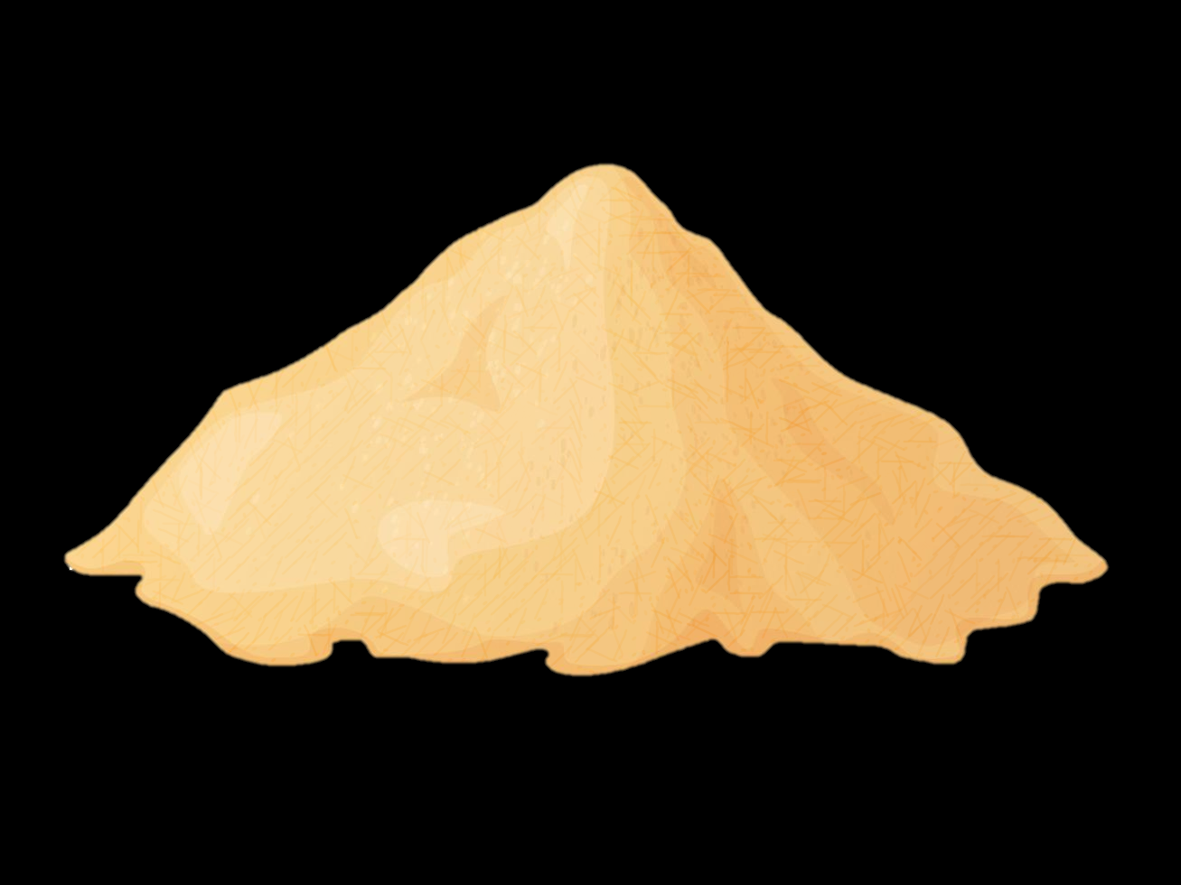

Introduction
BEP Experiment
Digital Twin Implementation
Dashboards and Results
Conclusions
Digital Twin Implementation
From the experiment:
Static data
Parameters of soil
Set up and experiment geometry
Dynamic data
Head readings
Weight of discharged water over time
Images

Slide 8
Introduction
BEP Experiment
Digital Twin Implementation
Dashboards and Results
Conclusions
Digital Twin Implementation
Data Handling: Tailored tools for loading, processing, and analysis
Local Operation: No network dependency
Determines permeability
Uses finite element BEP model D-Geo Flow (via PythonGEOLib 2.6.0)
Develops empirical analyses
Compares predicted vs observed behavior
Generates interactive plots
Presented in a dashboard built using Flask in Python and HTML
Notes:
Since the data comes in different formats, we use tailored tools to load, process, and analyze it. The digital twin operates locally (no network dependency)
Hydraulic Analysis – Determines hydraulic conductivity from pressure gradients and discharge, and from sand properties
Spatial Interpolation – Creates pressure maps to visualize data distribution.
Numerical Modeling – Uses the finite element BEP model D-Geo Flow (via PythonGEOLib 2.6.0) for deeper analysis.
Empirical Modeling – Incorporates Sellmeijer (2011) and Bligh (1910) equations for additional insights.
5.Data Visualization – Generates interactive graphs with Plotly to explore trends and behaviors.
To ensure future adaptability and scalability of the digital twin the code will be built in a modular and maintainable way
SHOW THE DIGITWIN

Slide 9
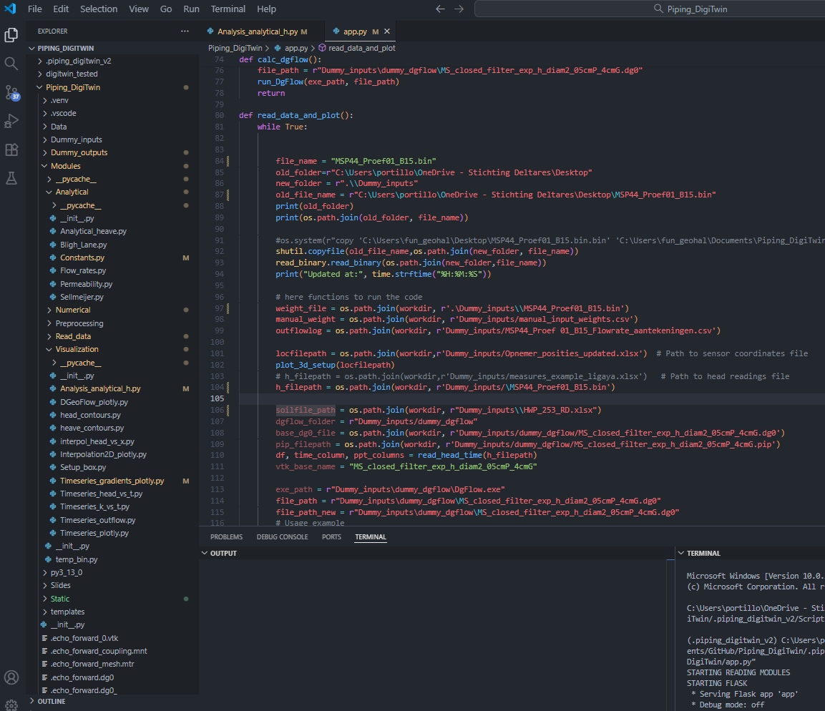
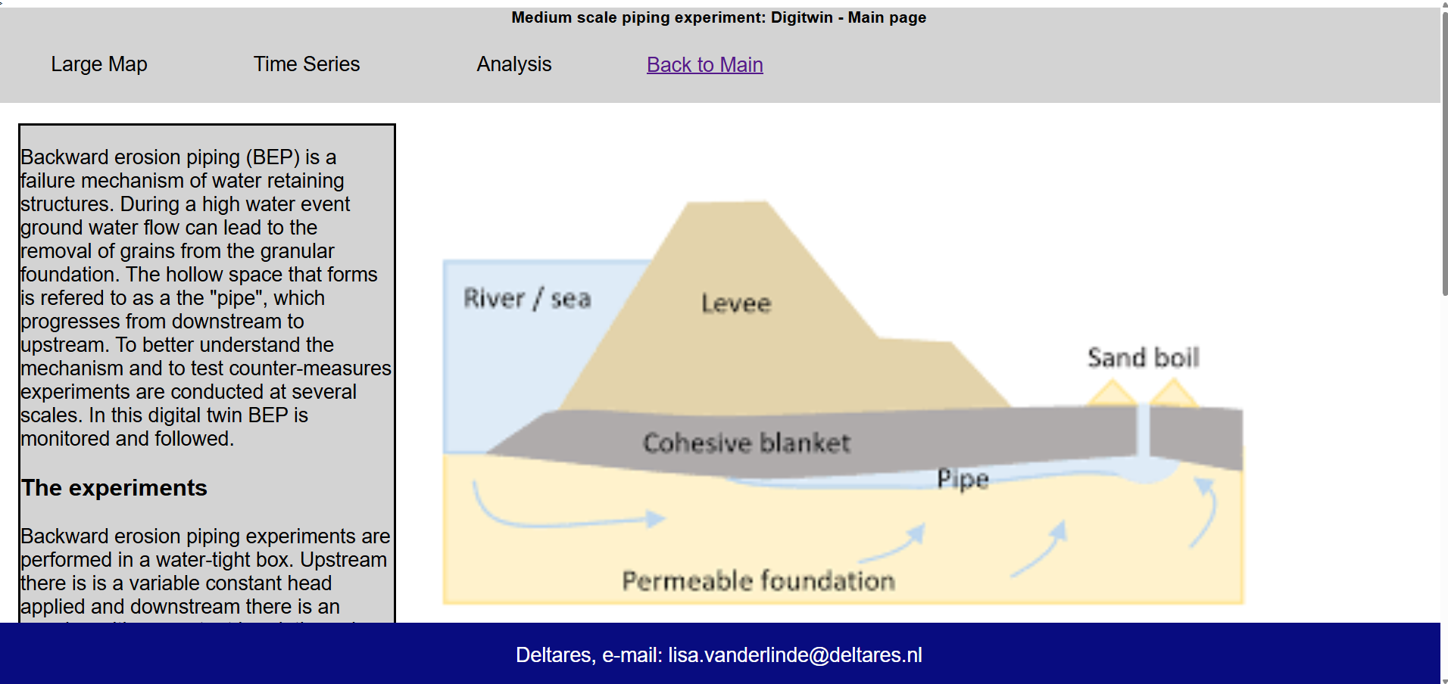
Introduction
BEP Experiment
Digital Twin Implementation
Dashboards and Results
Conclusions

Slide 10
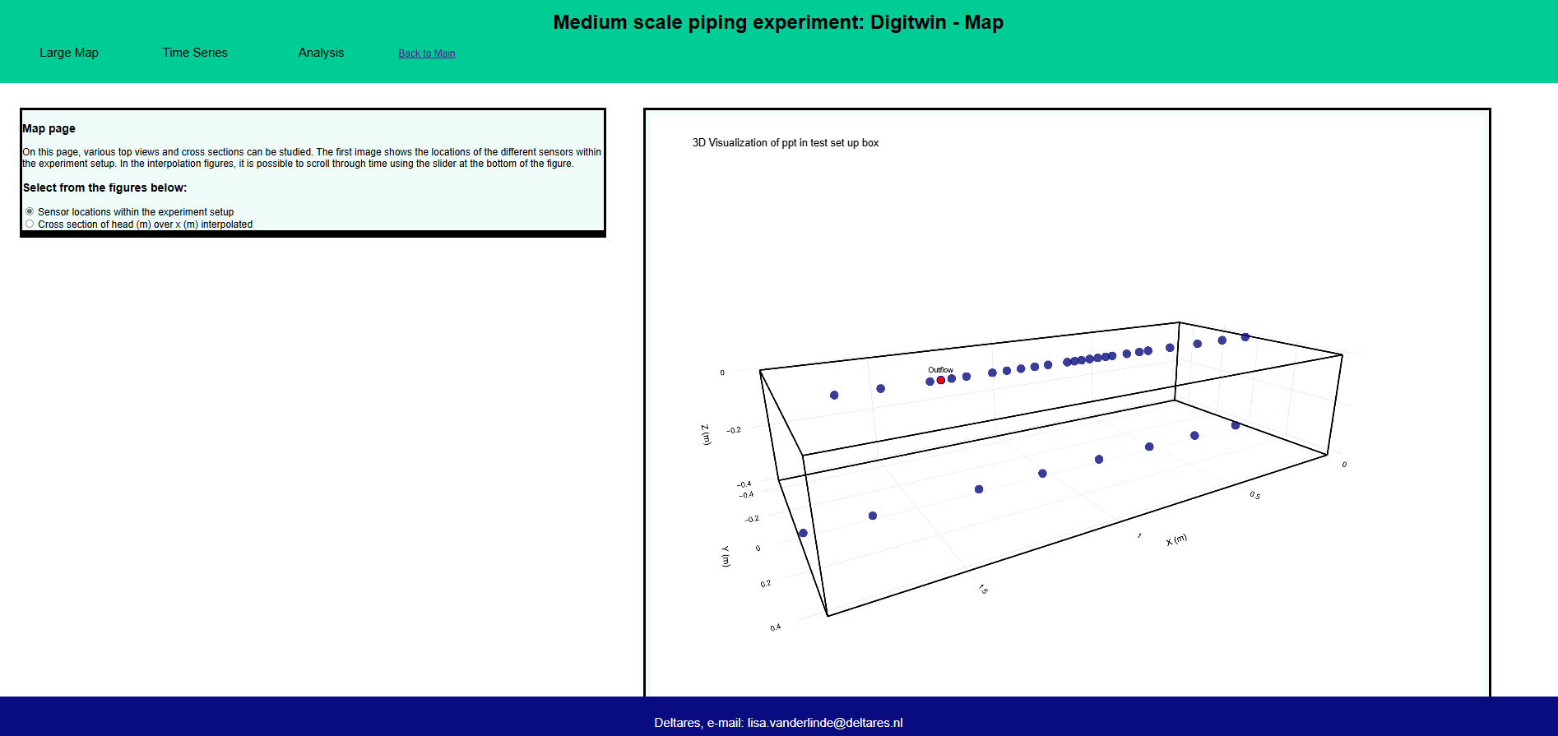
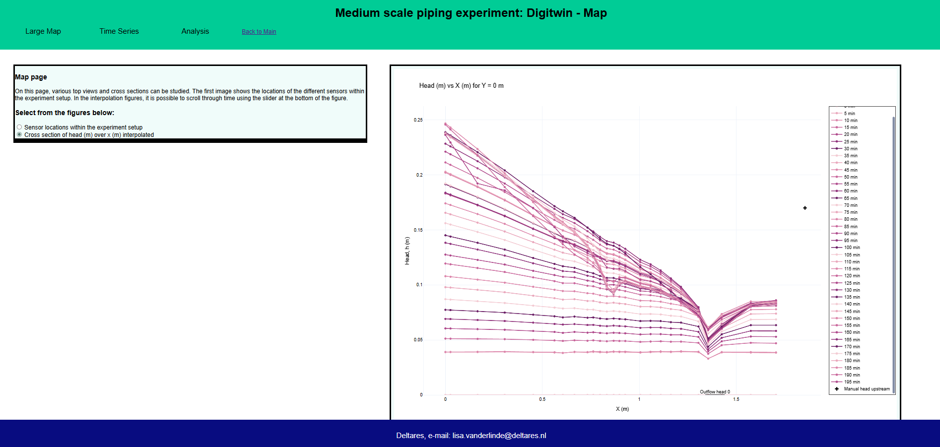
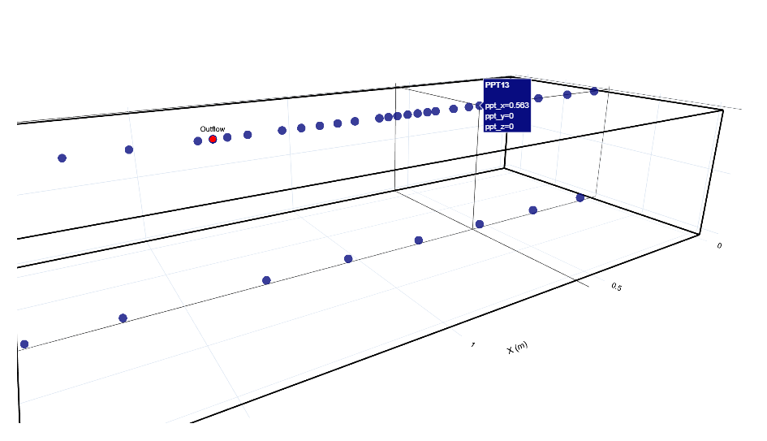
Introduction
BEP Experiment
Digital Twin Implementation
Dashboards and Results
Conclusions

Slide 11
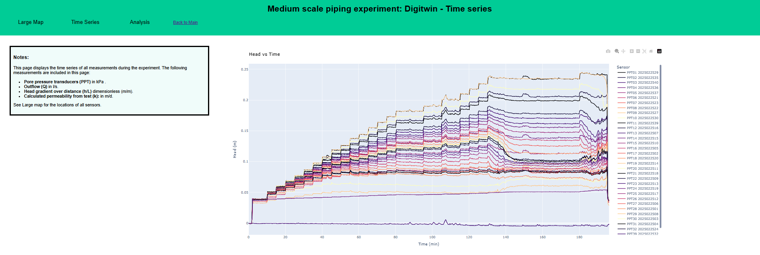
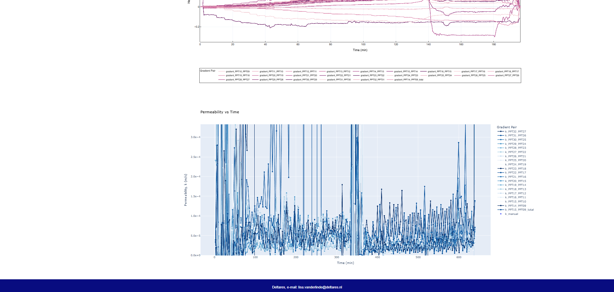
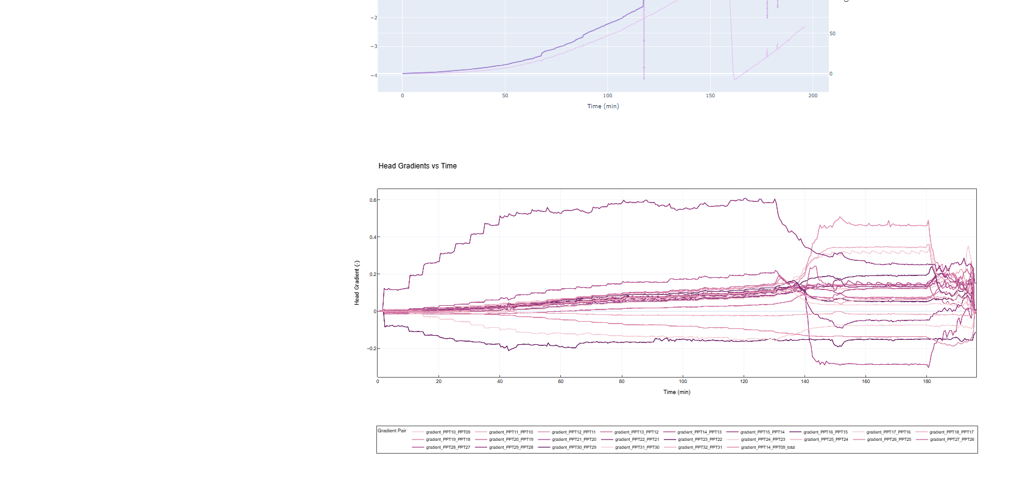
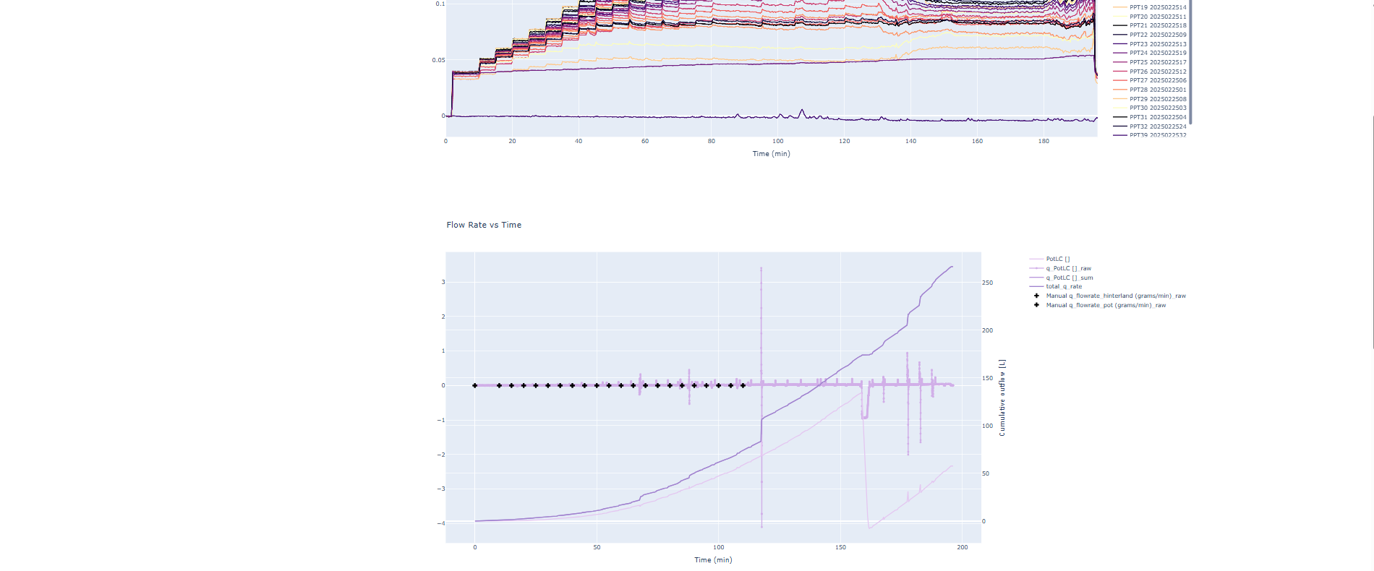
Introduction
BEP Experiment
Digital Twin Implementation
Dashboards and Results
Conclusions

Slide 12
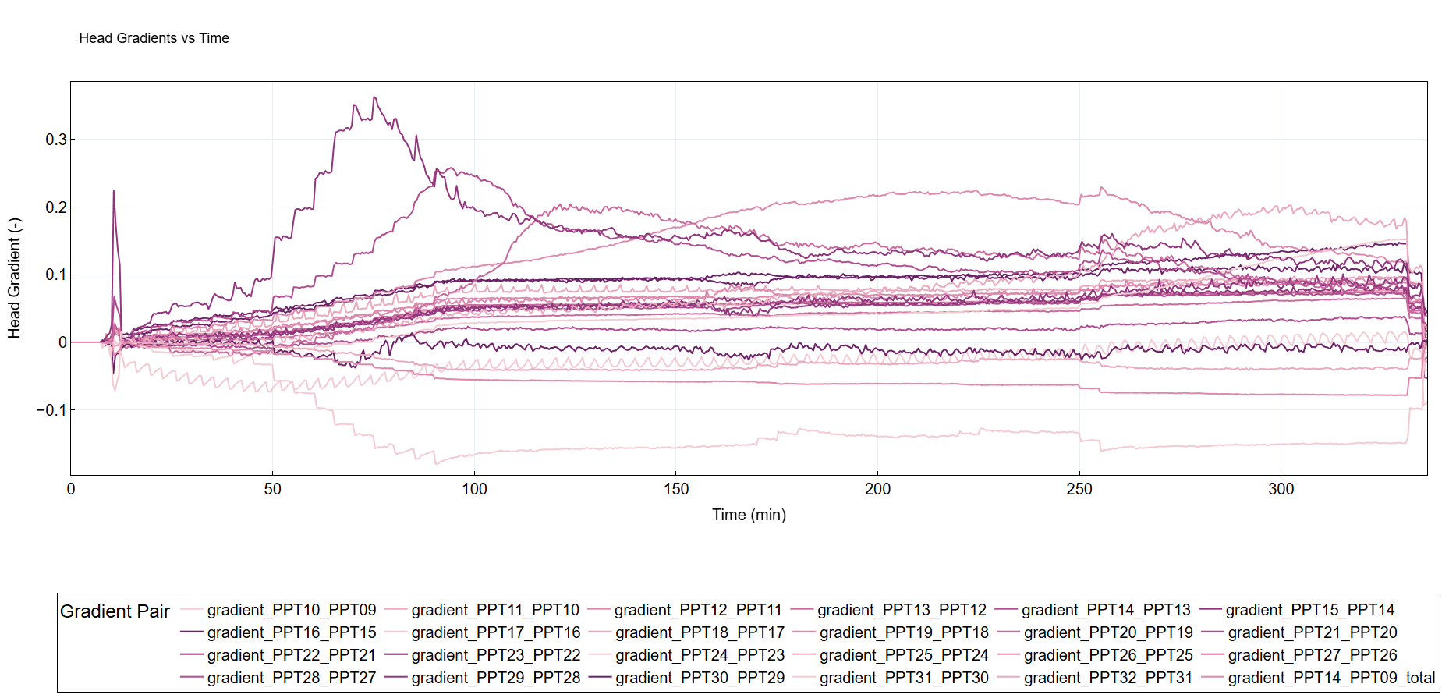
Introduction
BEP Experiment
Digital Twin Implementation
Dashboards and Results
Conclusions

Slide 13
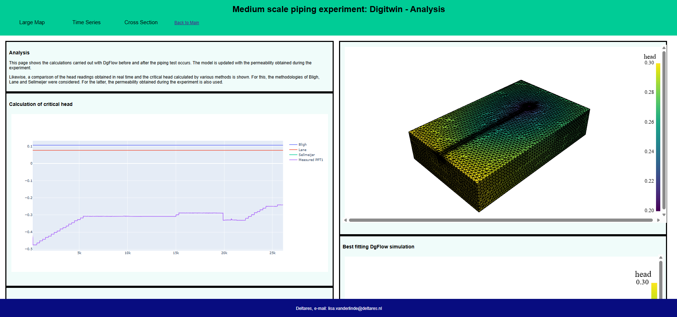
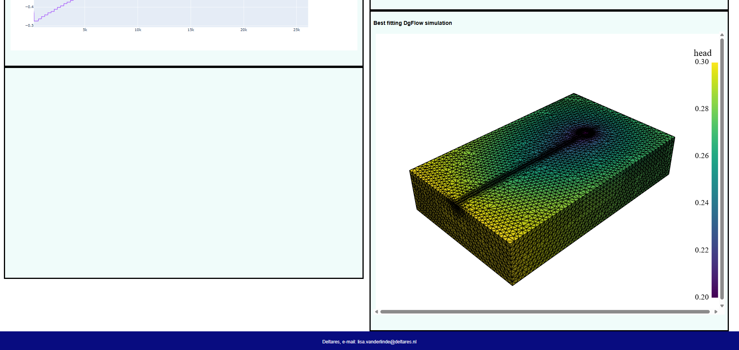
Introduction
BEP Experiment
Digital Twin Implementation
Dashboards and Results
Conclusions
Analysis

Slide 14
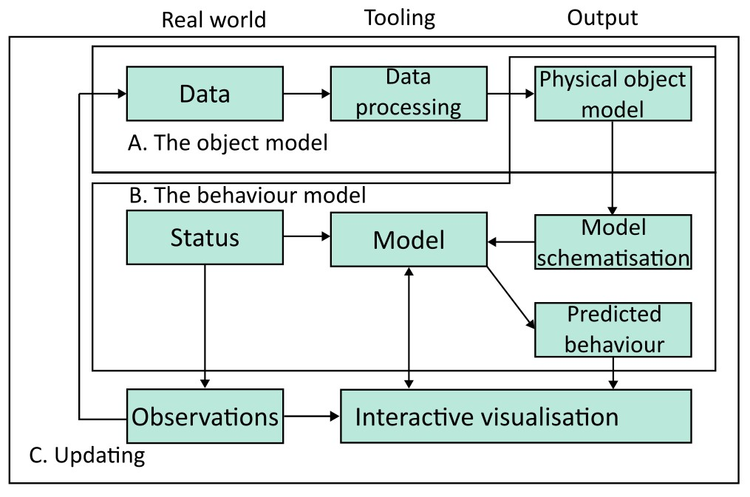
Introduction
BEP Experiment
Digital Twin Implementation
Dashboards and Results
Conclusions
Digital Twin Flowchart

Slide 15
Conclusions
Introduction
BEP Experiment
Digital Twin Implementation
Dashboards and Results
Conclusions
Enables near real-time visualisation of pore pressures, flow rates, and gradients.
Interactive analysis of trends and understanding of failure mechanisms, improving the learning curve.
The Digital Twin provided continuous insights into the BEP experiment.
Compares predicted behavior (critical head, pipe length) with observed outcomes
Supported decision-making during the experiment

Slide 16
Conclusions
Introduction
BEP Experiment
Digital Twin Implementation
Dashboards and Results
Conclusions
Well-organized data for easier tracking, comparison, and analysis across multiple experiments.
Reduces manual workload.
Linked physical observations and numerical simulations

Slide 17
Current limitations
Introduction
BEP Experiment
Digital Twin Implementation
Dashboards and Results
Conclusions
Dependable on quality and availability of measurements
So far, not possible to include pipe-depth development
Data handling

Slide 18
Future
Introduction
BEP Experiment
Digital Twin Implementation
Dashboards and Results
Conclusions
Adaptable for smaller/larger scales
Apply Digital Twins to other types of experiments
Expand system with additional monitored data or images.
Apply framework to other failure mechanisms.
Integrate other numerical models.
Notes:
no continuous measurements will be performed on the pipe depth, therefore it is impossible include the pipe-depth development in the digital twin.

Slide 19
References
Van Beek, V., Robbins, B., Rosenbrand, E., Esch, J. (2022). 3D modelling of backward erosion piping experiments. Geomechanics for Energy and the Environment. 31. 100375: 10.1016/j.gete.2022.100375.
Van der Linde, E. M., Fransen, M. P., Portillo Arreguin, D. M., van Beek, V. M. (2025). Proposal for a digital twin for backward erosion piping experiments, In: Name of Conference Proceedings, Brno, Czechia.
Deltares (2025). 11210465-002-GEO-0002 KIA Piping op Veldschaal - WP1.3. Feitelijk rapport pipingproeven. Deltares, Delft.
Van Esch, J. M., Sellmeijer, J. B., & Stolle, D. (2013). Modelling transient groundwater flow and piping under dikes and dams. In: 3rd International Symposium on Computational Geomechanics (ComGeo III) (Vol. 9). Taylor I & Francis. Krakow, Poland.
Sellmeijer, H., de la Cruz, J. L., van Beek, V. M., & Knoeff, H. (2011). Fine-tuning of the backward erosion piping model through small-scale, medium-scale and IJkdijk experiments. European Journal of Environmental and Civil Engineering, 15(8), 1139-1154.

