Slide 1

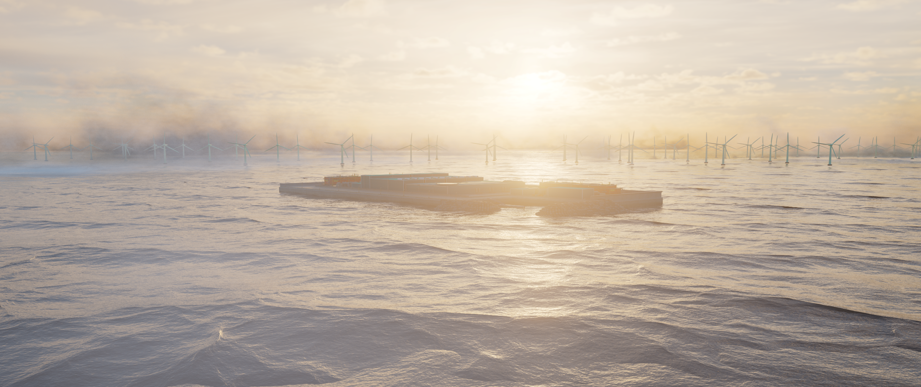



Key design lessons learned of Princess Elisabeth Island
Reza Shahbazi
José Rocha
11/11/2025

Slide 2
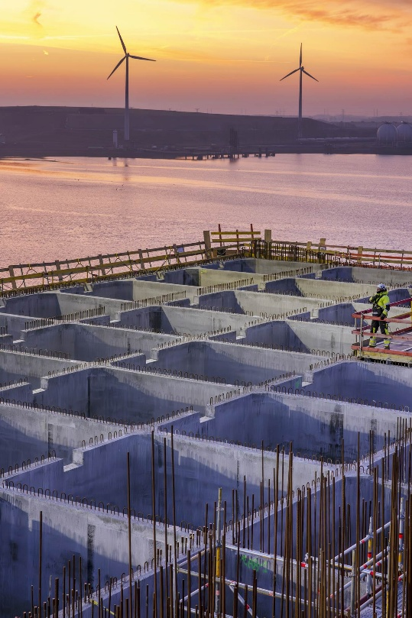
AGENDA
01 | Introduction overall project
02 | Rockmound large-scale testing
03 | Stability under extreme wave
04 | 3D settlement & stability assessments
05 | Construction sequencing

Slide 3
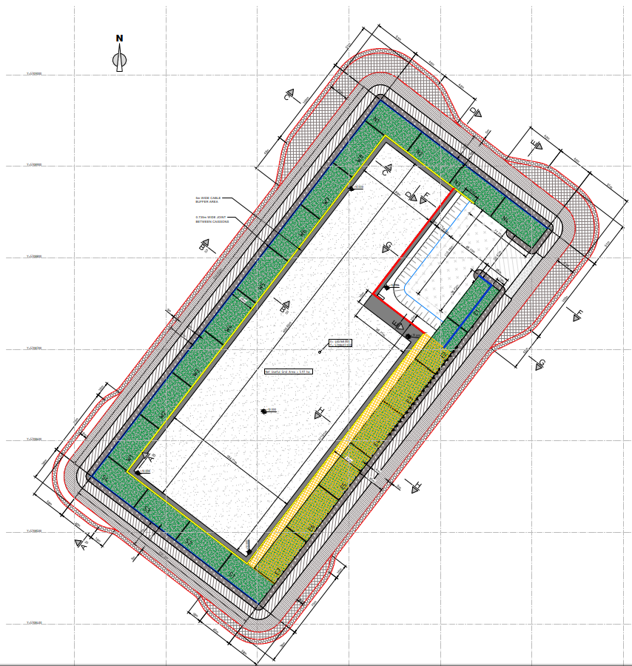
INTRODUCTION OVERALL PROJECT
Main Objects – EPCI Works
Fabrication, transport and installation of 23 caissons (57m long, 28m wide, 22m high + wave walls). >200.000 m³ concrete + > 40.000 tons rebar + 95 cable entries.
Procurement and installation of > 400.000 m³ rockworks.
Dredging, reclamation and compaction of sand fill. > 3.000.000 m³.
Finishing works such as CTV harbour revetment (82.000 m ³),CTV furniture, aids to navigation, jetty, cable culverts and ring road.
Roughly 40km away from Belgium coast

Slide 4
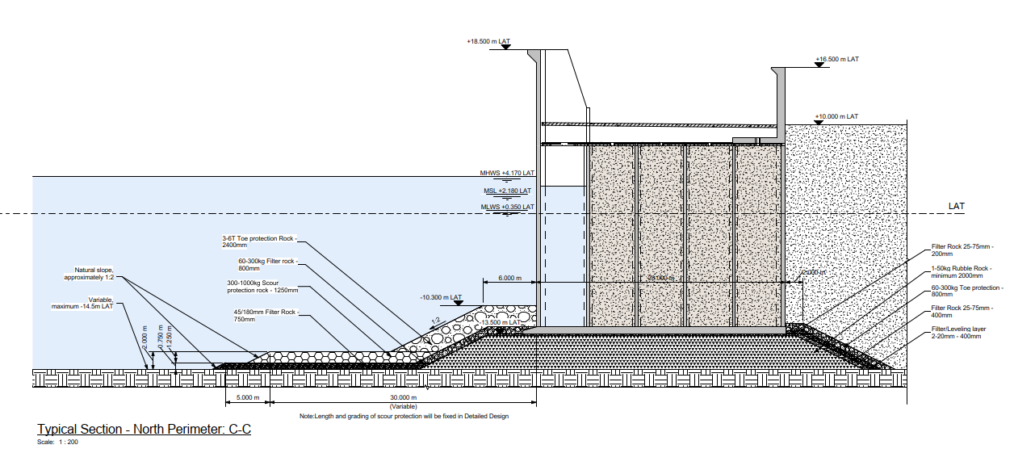
INTRODUCTION OVERALL PROJECT
Phasing
Seabed leveling
Foundation installation
Caisson installation
Toe protection
Island reclamation

Slide 5
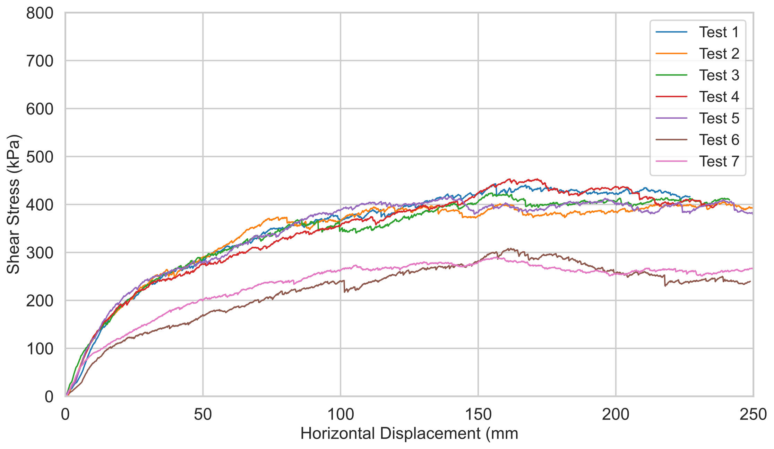
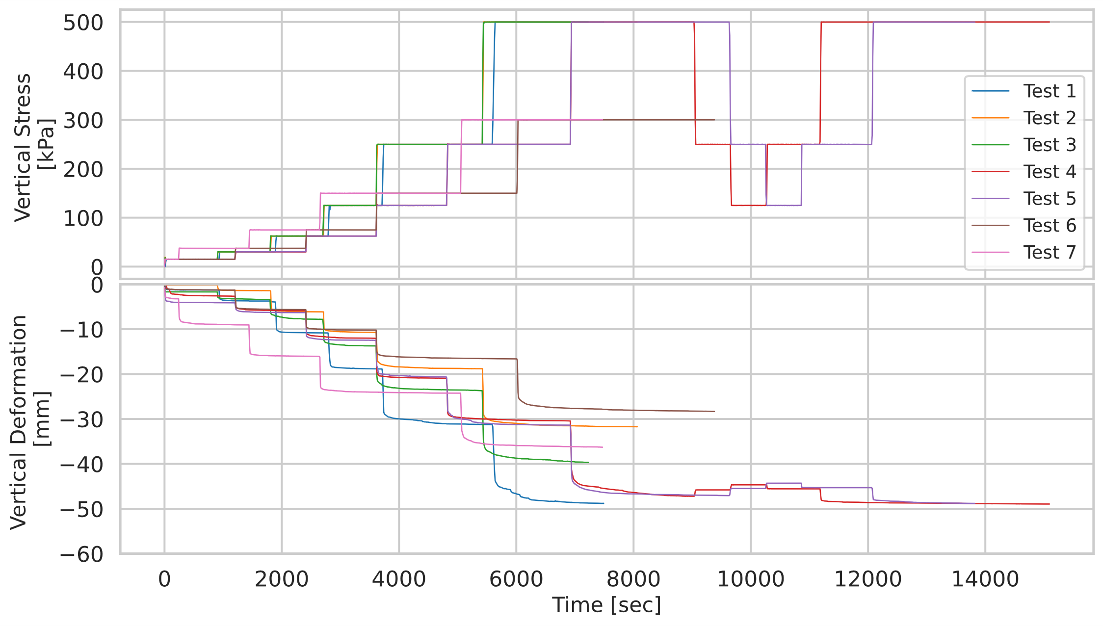
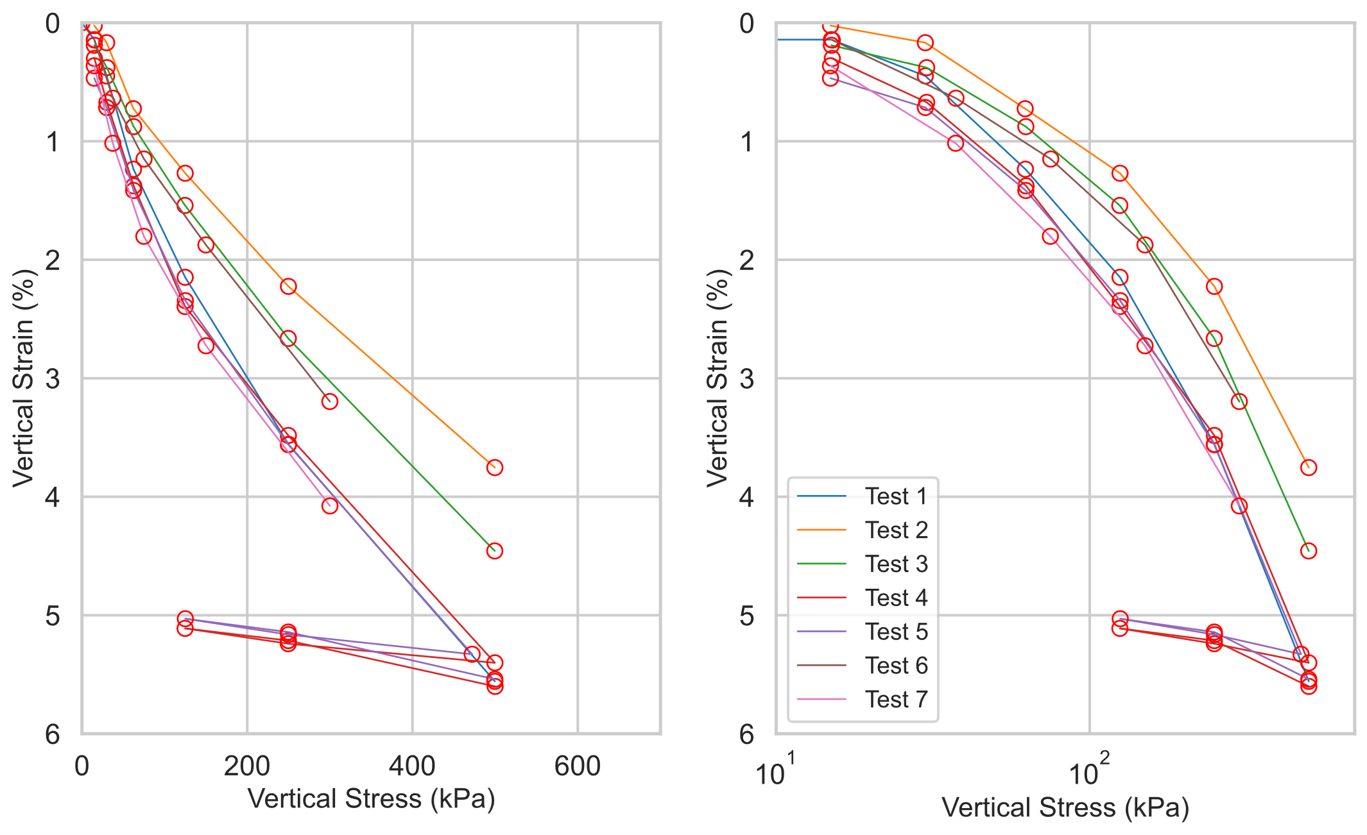
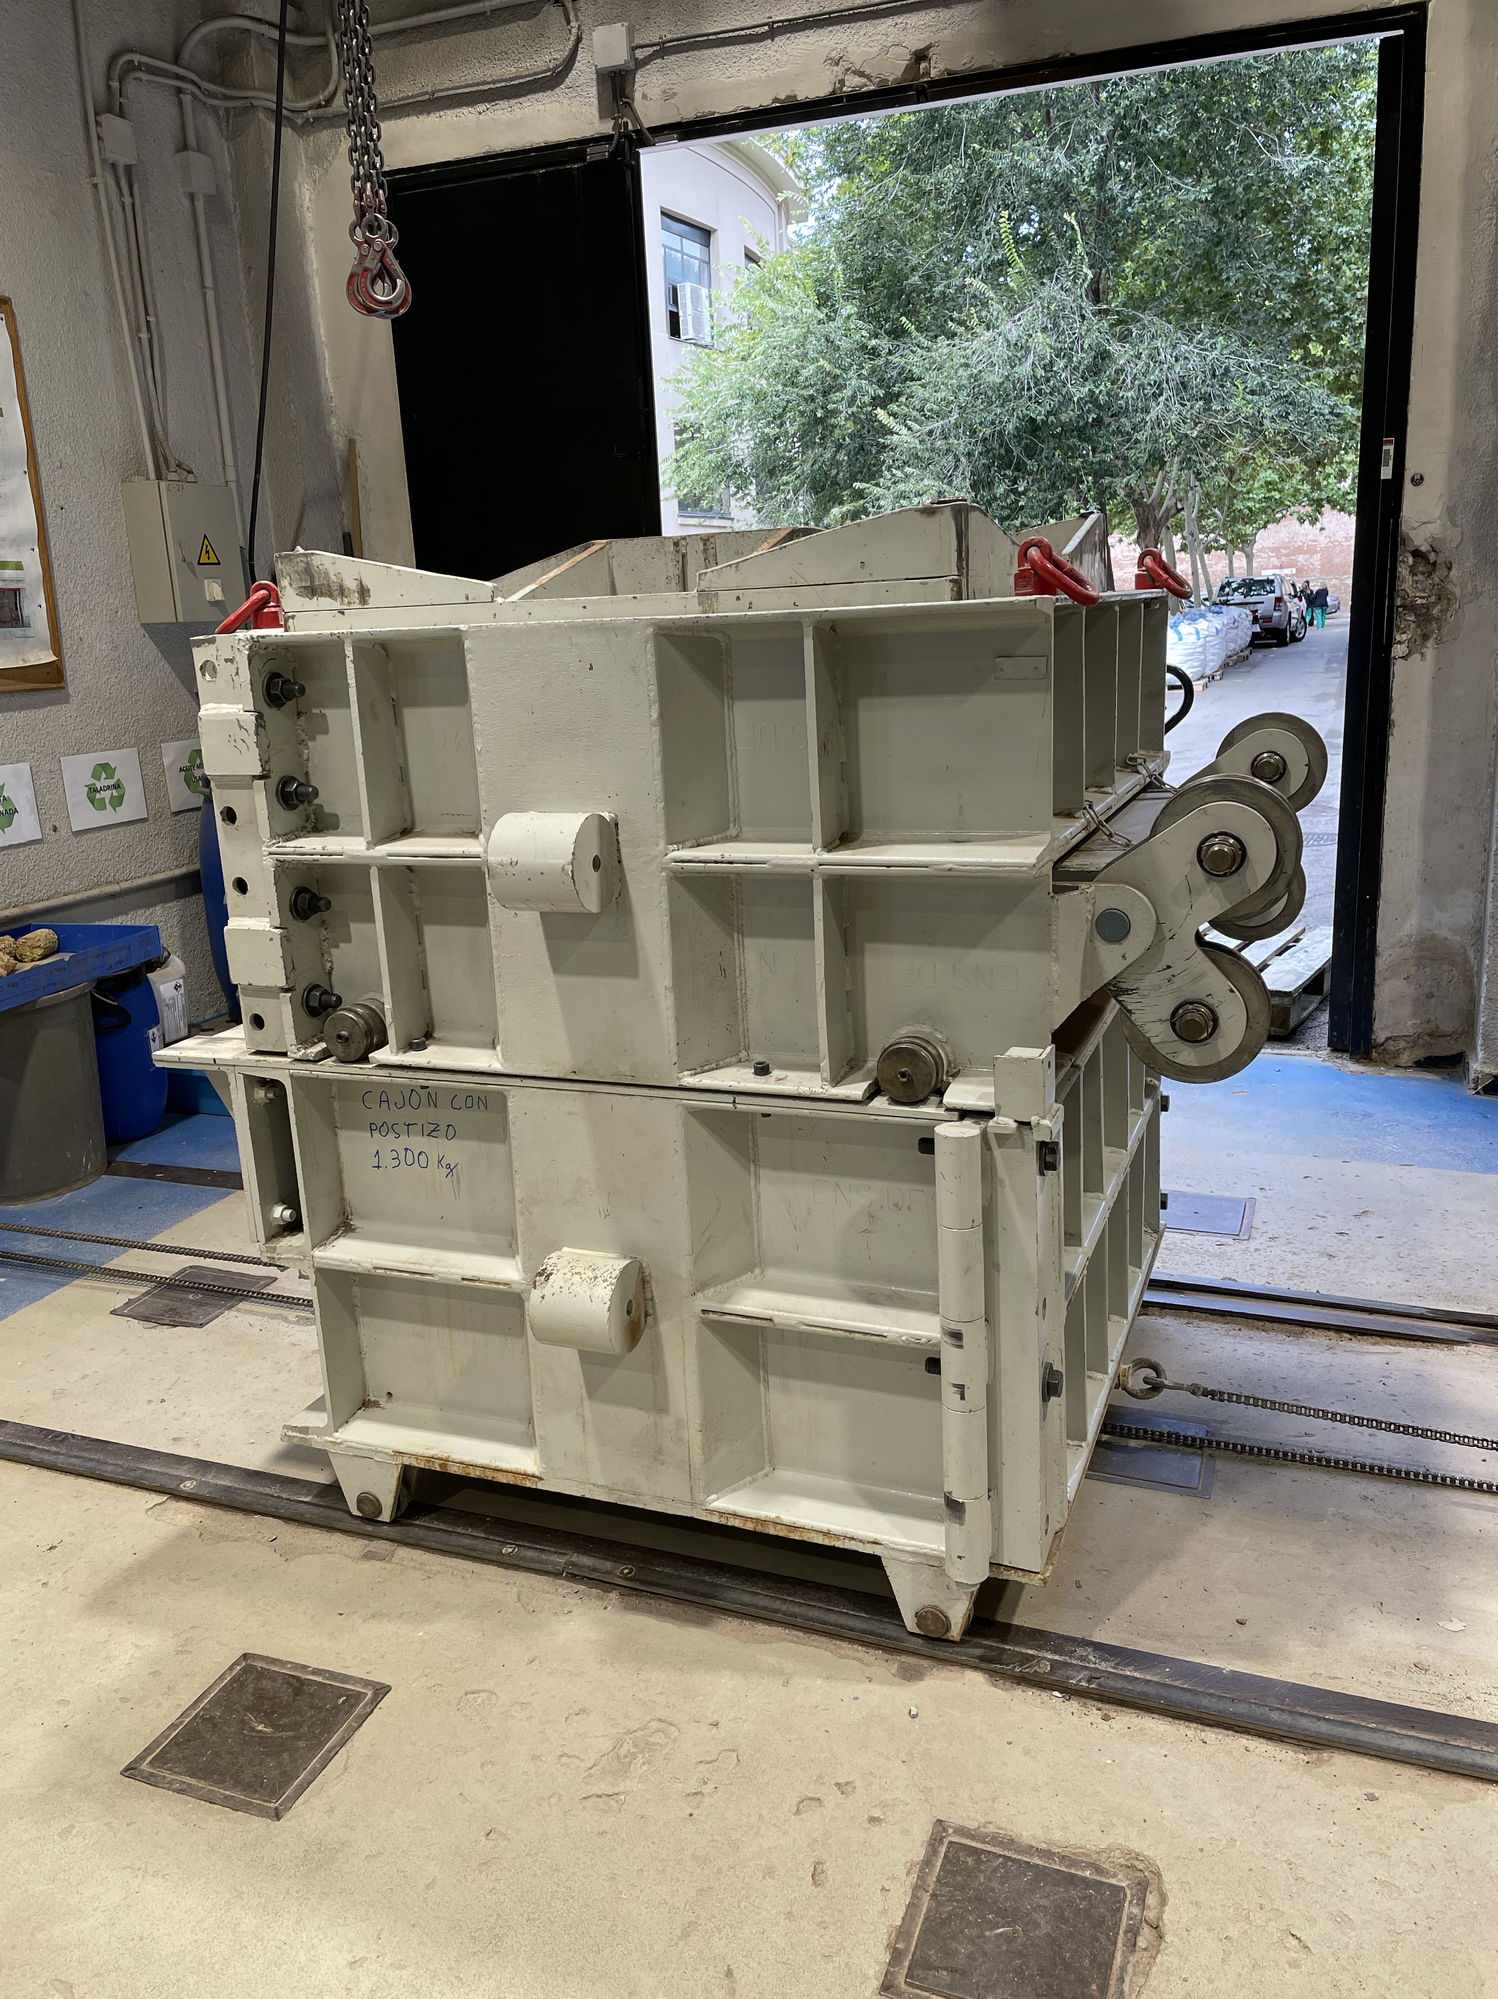
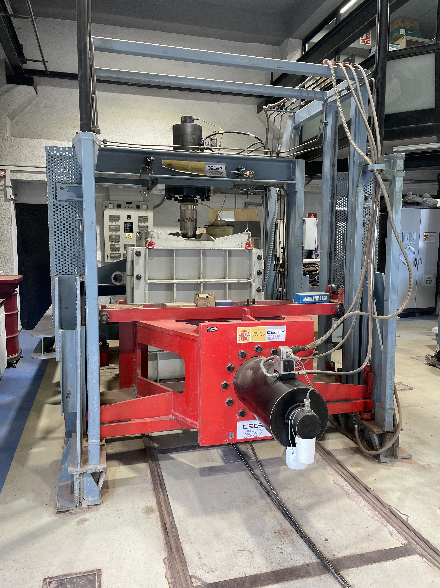
ROCKMOUND LARGE-SCALE TESTING
Notes:
The large-scale test results were used to calibrate the strength and compressibility parameters in PLAXIS, applying the Hardening Soil Small-Strain model to simulate the rock mound behavior.

Slide 6
5 GEOTECHNICAL DESIGN INSIGHTS

Slide 7
1- STABILITY IN EXTREME OFFSHORE ENVIRONMENT
direction of wave
Lw
crest
(still) SWL
Hw
trough
seabed

Slide 8
1- STABILITY IN EXTREME OFFSHORE ENVIRONMENT
direction of wave
Lw
crest
(still) SWL
Hw
trough
In the PEI: Hs=8.5m!
seabed

Slide 9
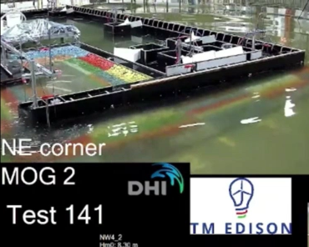
1- STABILITY IN EXTREME OFFSHORE ENVIRONMENT
direction of wave
crest
(still) SWL
trough
seabed

Slide 10

1- STABILITY IN EXTREME OFFSHORE ENVIRONMENT
direction of wave
Lw
crest
(still) SWL
Lw/2 >
trough
seabed

Slide 11
1- STABILITY IN EXTREME OFFSHORE ENVIRONMENT
direction of wave
crest
(still) SWL
C
T
trough
seabed

Slide 12
1- STABILITY IN EXTREME OFFSHORE ENVIRONMENT
direction of wave
crest
(still) SWL
C
T
trough
seabed
Scenario dependent

Slide 13
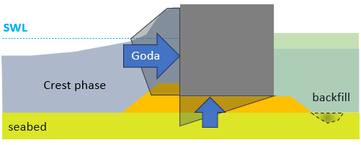
1- STABILITY IN EXTREME OFFSHORE ENVIRONMENT
Wave crest: Goda theory; ideal for breakwaters

Slide 14
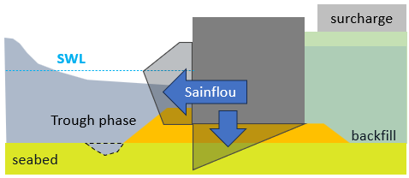
1- STABILITY IN EXTREME OFFSHORE ENVIRONMENT
Wave crest: Goda theory
Wave trough: Sainflou theory

Slide 15
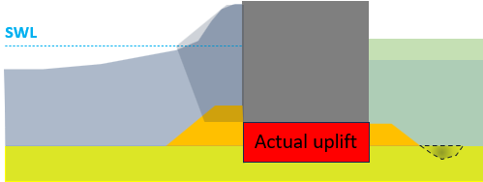

1- STABILITY IN EXTREME OFFSHORE ENVIRONMENT
Wave crest: Goda theory
$k_{rubble}≫ k_{sand}$
flow
Wave trough: Sainflou theory

Slide 16
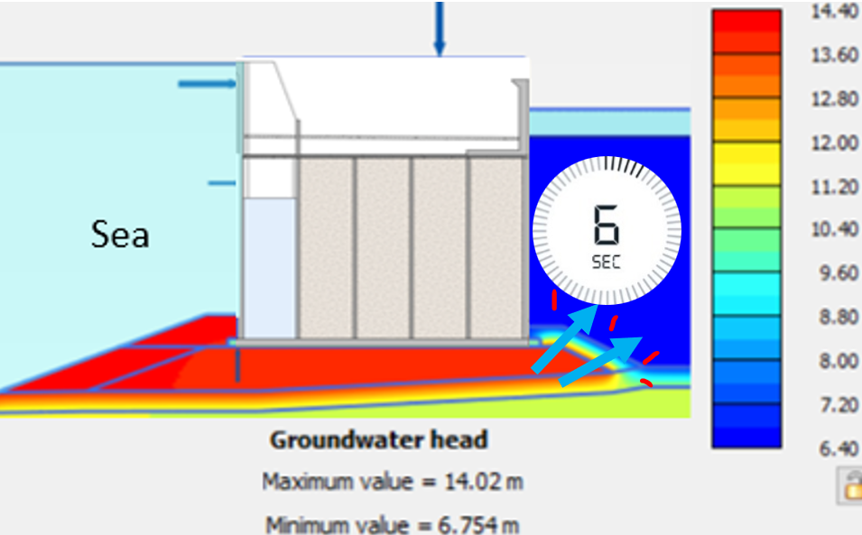
1- STABILITY IN EXTREME OFFSHORE ENVIRONMENT
Wave crest: Goda theory
$k_{rubble}≫ k_{sand}$
flow
Wave trough: Sainflou theory

Slide 17
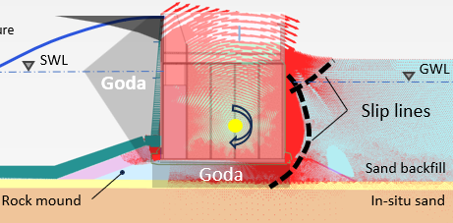
1- STABILITY IN EXTREME OFFSHORE ENVIRONMENT
Wave crest: Goda theory
$k_{rubble}≫ k_{sand}$
flow
Safe to incorporate wave flow
Wave trough: Sainflou theory

Slide 18
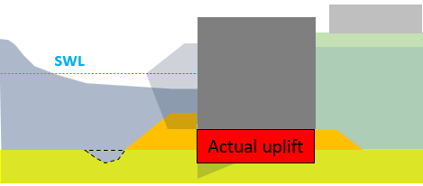

1- STABILITY IN EXTREME OFFSHORE ENVIRONMENT
Wave crest: Goda theory
$k_{rubble}≫ k_{sand}$
flow
Safe to incorporate wave flow
Wave trough: Sainflou theory
$k_{rubble}≫ k_{sand}$
flow

Slide 19
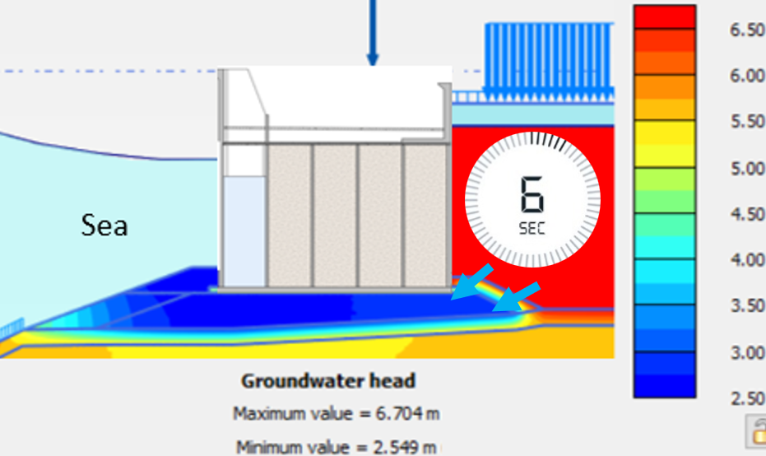
1- STABILITY IN EXTREME OFFSHORE ENVIRONMENT
Wave crest: Goda theory
$k_{rubble}≫ k_{sand}$
flow
Safe to incorporate wave flow
Wave trough: Sainflou theory
$k_{rubble}≫ k_{sand}$
flow

Slide 20
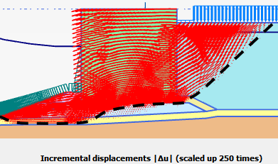
1- STABILITY IN EXTREME OFFSHORE ENVIRONMENT
Wave crest: Goda theory
$k_{rubble}≫ k_{sand}$
flow
Safe to incorporate wave flow
Wave trough: Sainflou theory
$k_{rubble}≫ k_{sand}$
flow
Slip line
Less uplift pressures could help to optimize rock quantity for toe and scour protections

Slide 21
2- 3D SETTLEMENT AND ROTATION
3D Plaxis settlement analysis up to 100 years after handover was performed

Slide 22
2- 3D SETTLEMENT AND ROTATION
3D Plaxis settlement analysis up to 100 years after handover was performed.
HS Small for sand
Soft Soil Creep (SSC) for clay
Sand
t=15~20m
clay

Slide 23
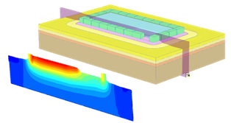
2- 3D SETTLEMENT AND ROTATION
3D Plaxis settlement analysis up to 100 years after handover was performed.
HS Small for sand
Soft Soil Creep (SSC) for clay
Sand
t=15~20m
clay

Slide 24
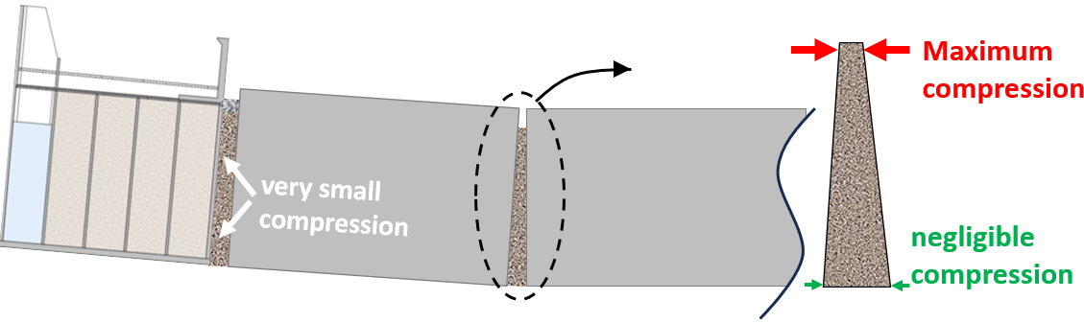
2- 3D SETTLEMENT AND ROTATION
quasi-permanent actions

Slide 25
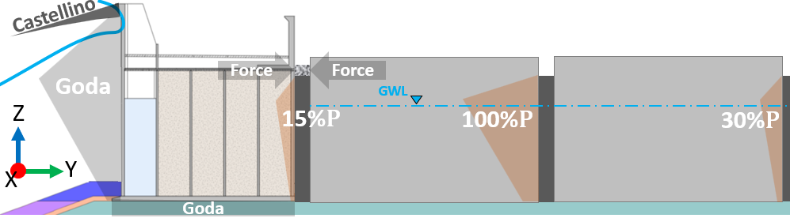
2- 3D SETTLEMENT AND ROTATION
quasi-permanent actions
Dynamic actions added to quasi-permanent actions

Slide 26
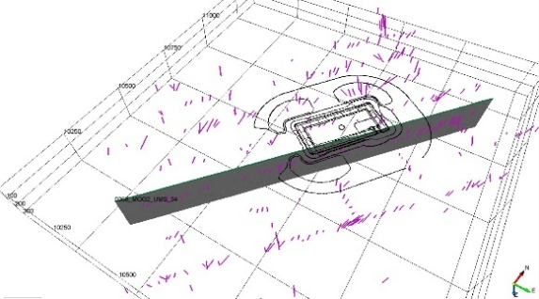
3- FISSURED AND FRACTURED YPRESIAN CLAY
geophysics

Slide 27
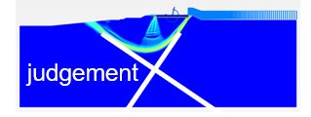
3- FISSURED AND FRACTURED YPRESIAN CLAY
geophysics
Incorporated into Plaxis models as discontinuities at the worst locations
geophysics

Slide 28
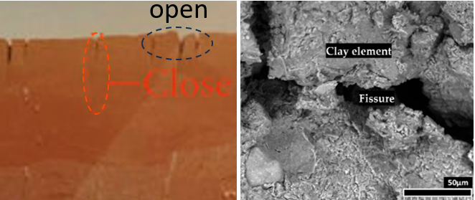
3- FISSURED AND FRACTURED YPRESIAN CLAY
geophysics
Incorporated into Plaxis models as discontinuities at the worst locations
geophysics

Slide 29
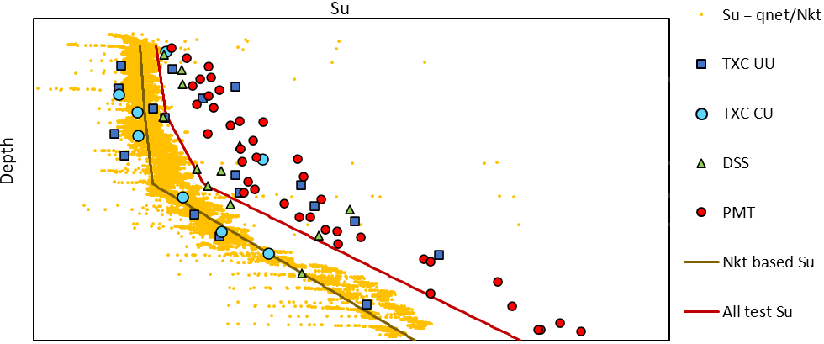
3- FISSURED AND FRACTURED YPRESIAN CLAY
geophysics
Incorporated into Plaxis models as discontinuities at the worst locations
Reflected in Su profile

Slide 30
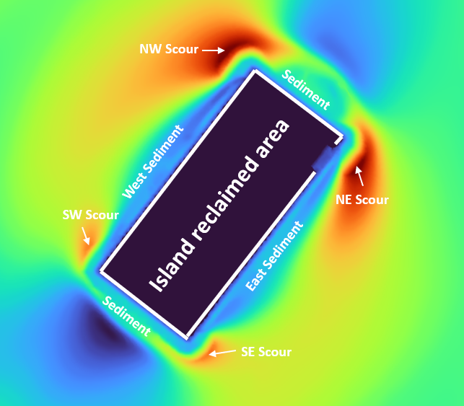
3- FISSURED AND FRACTURED YPRESIAN CLAY + EROSIONS
15m deep erosion!
yearly bathymetry is a key input!

Slide 31
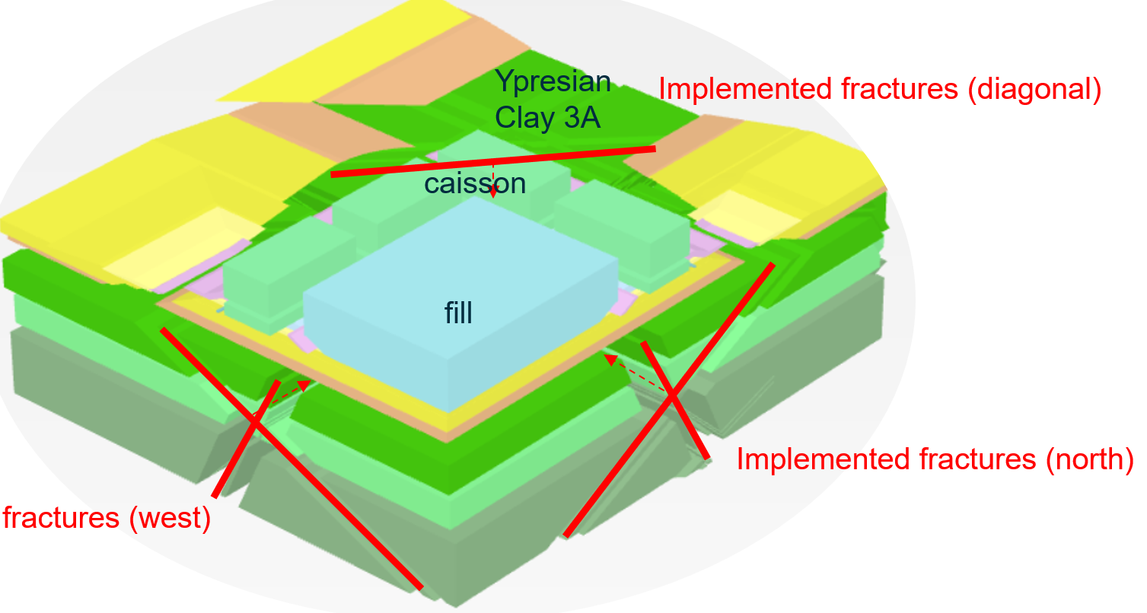
3- FISSURED AND FRACTURED YPRESIAN CLAY + EROSIONS
Plaxis 3D simulation; essential for corner caissons
15m deep erosion!
yearly bathymetry is a key input!

Slide 32
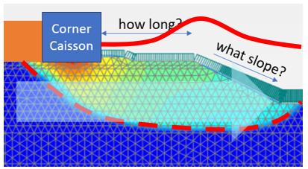
3- FISSURED AND FRACTURED YPRESIAN CLAY + EROSIONS
Plaxis 3D simulation; essential for corner caissons
15m deep erosion!
yearly bathymetry is a key input!

Slide 33
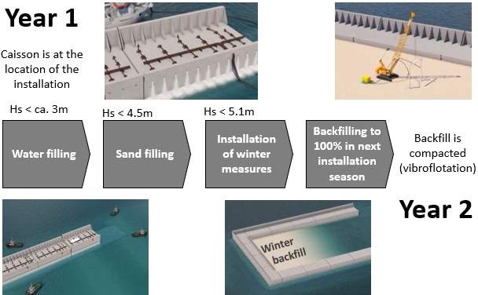
4- CONSTRUCTION SEQUENCING: OVERVIEW

Slide 34
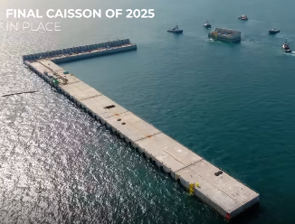
4- CONSTRUCTION SEQUENCING: OVERVIEW

Slide 35
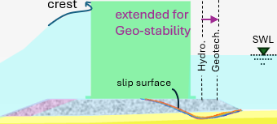

4- CONSTRUCTION SEQUENCING: SUMMER & WINTER
Minimum rock mound sustaining summer
Hydraulic starts, Geotech completes

Slide 36
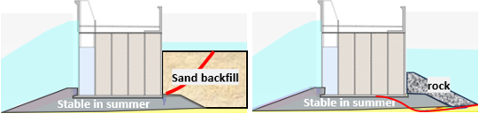
4- CONSTRUCTION SEQUENCING: SUMMER & WINTER
Minimum rock mound sustaining summer
Hydraulic starts, Geotech completes
Backfill before winter season

Slide 37
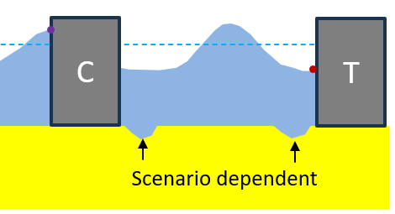
4- CONSTRUCTION SEQUENCING: SUMMER & WINTER
Minimum rock mound sustaining summer
Hydraulic starts, Geotech completes
Backfill before winter season
Regular erosion monitoring planned

Slide 38
5- CYCLIC DEGRADATION
In operational scenarios
Verified with UDCAM-S (NGI) cyclic accumulation model for clay
Conclusion: No significant degradation

Slide 39
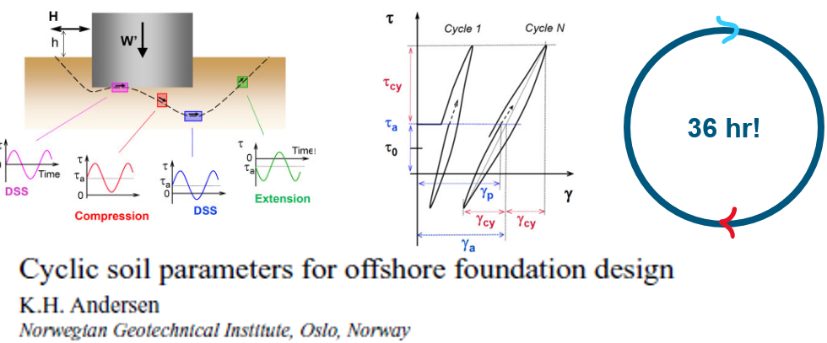
5- CYCLIC DEGRADATION
In operational scenarios
Verified with UDCAM-S (NGI) cyclic accumulation model for clay
Conclusion: No significant degradation

Slide 40
5- CYCLIC DEGRADATION
In operational scenarios
Verified with UDCAM-S (NGI) cyclic accumulation model for clay
Conclusion: No significant degradation
In construction scenarios
UDCAM-S was too conservative results mainly due to disregarding drainage
PM4SAND proved that pre-compaction sand suffices

Slide 41
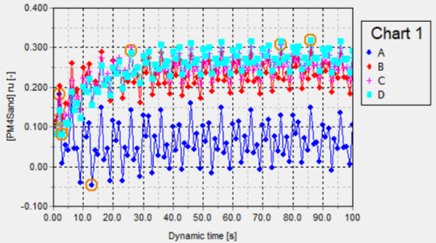
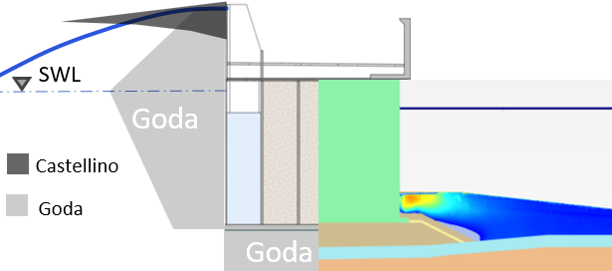
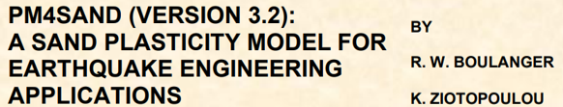
5- CYCLIC DEGRADATION
In operational scenarios
Verified with UDCAM-S (NGI) cyclic accumulation model for clay
Conclusion: No significant degradation
In construction scenarios
UDCAM-S was too conservative results mainly due to disregarding drainage
PM4SAND proved that pre-compaction sand suffices
𝜑res=𝜑(ru)

Slide 42
TAKEAWAYS
Multidisciplinary iteration between hydraulic, structural & geotechnical teams and parties has been crucial
Advanced tools has facilitated optimizations, but in-depth and multidisciplinary reviews are critical to maintain the right direction
Some of the advanced approaches like 3D flow-stress analyses might seem expensive in engineering but can save considerable earthworks
Smart monitoring can relax over-conservatism to some extend and pave the way towards more realistic assumptions in design

Slide 43
ACKNOWLEDGEMENTS & CONTACT
HASKONING was honored to support TME (DEME GROUP & JAN DE NUL GROUP)
Elia (OE) has shown high attention in supervising the work
DNV has shown high interest and dedication in reviewing the design work

Slide 44
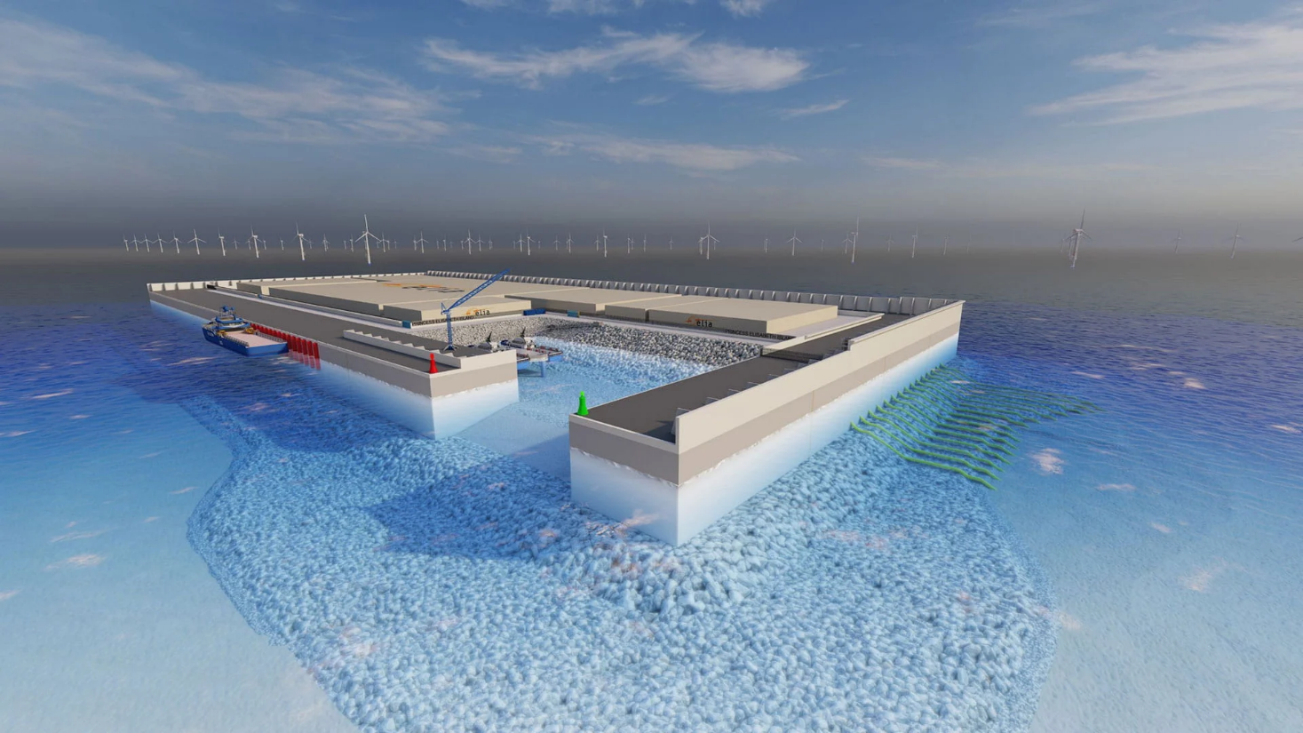
Thank you!

