Slide 1


KIVI
Royal Netherlands Society of Engineers
2026
KIVI connects, strengthens and represents engineers throughout the Netherlands.

Slide 2
Note! To use this presentation properly, you need the Montserrat font family installed.
Click here to download & install it.

Slide 3

Contents
About KIVI
Why KIVI
Network & knowledge
Chartered Engineering

Slide 4

Engineering is where curiosity meets creation and ideas become reality.

Slide 5
ABOUT KIVI
//ROYAL NETHERLANDS SOCIETY OF ENGINEERS

Slide 6

About us
ROYAL NETHERLANDS SOCIETY OF ENGINEERS // ABOUT KIVI
WHAT WE DO
01
Advocacy
A strong voice for engineers
02
Network & knowledge
300+ activities a year
THE PROFESSIONAL BODY FOR ALL ENGINEERS IN THE NETHERLANDS: EVERY DISCIPLINE, EVERY CAREER STAGE.
03
Professional growth
Training, coaching & certification
FOUNDED IN
KIVI MEMBERS
1847
12,000+

Slide 7

KIVI MISSION
ROYAL NETHERLANDS SOCIETY OF ENGINEERS // ABOUT KIVI
Mission
Supporting engineers in their development and making their value to society visible.
Connect
engineering with education, research, business & society
Quality
of engineering education and research
Strength
of engineers, harnessed for societal challenges
Impact
of technology, made visible

Slide 8
WHY KIVI
//THE ADDED VALUE

Slide 9

MEMBERSHIP
THE ADDED VALUE // WHY KIVI
300+ KIVI events
& company visits
12,000+
members
KIVI coaching
& Academy
Strong multidisciplinary engineering network
Latest news &
industry insights
Personal development
Engineering magazine
De Ingenieur
Print or online
mobile app
THE LARGEST MULTIDISCIPLINARY ENGINEERING NETWORK IN THE NETHERLANDS.

Slide 10
Member benefits
THE ADDED VALUE // WHY KIVI
300+
KIVI events & company visits a year
80+
engineering coaches for growth & insight
12×
issues a year of De Ingenieur magazine
55+
trade journals at 15–100% off
50%
off meeting rooms at KIVI HQ
12
knowledge & training partners in the KIVI Academy
+ online community · insurance discount via SAA

Slide 11
DIVERSE DISCIPLINES
THE ADDED VALUE // WHY KIVI
Keep members up to date with developments in their field
38
Specialist divisions
8
Regions
2
Students & Young Professionals
Bring
members from each region
together
10
Circles
Multidisciplinary sections for students
& engineers up to
and including 35
Small-scale communities for knowledge sharing, networking and professional development
DEPTH IN YOUR FIELD, REGIONAL CONNECTIONS AND INSPIRATION FROM OTHER SECTORS AND GENERATIONS.

Slide 12
The future is built one calculation, one design, one decision at a time.

Slide 13


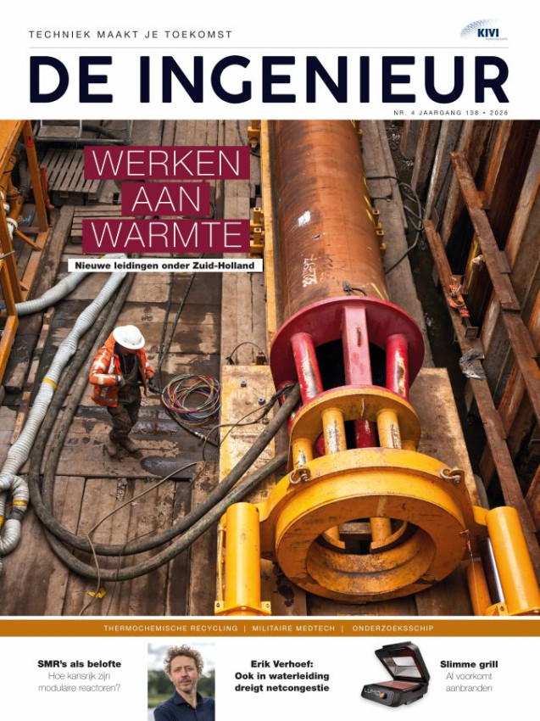


Magazine
De Ingenieur
THE ADDED VALUE // WHY KIVI
The engineering magazine
The #1 online platform for engineers.
Weekly newsletter & monthly magazine, online or in print.
Read the full De Ingenieur, or individual articles, in the mobile app.

Slide 14
ACTIVITIES
THE ADDED VALUE // WHY KIVI
300+ EVENTS
a year
Company visits,
excursions & study tours
Trade fairs & congresses
Symposia, presentations & theme days
Masterclasses, webinars & lectures
Drinks, online & offline networking
KIVI Annual Congress
& Prince Friso Engineering Award
Round-table discussions & debates
300+ GATHERINGS A YEAR: DEEPEN YOUR KNOWLEDGE, SHARE EXPERIENCES, MAKE NEW CONNECTIONS.

Slide 15
EVENTS
THE ADDED VALUE // WHY KIVI
Events: online and in person
300+
events a year
In person
Company visits & excursions
Symposia, congresses & trade fairs
Drinks & networking evenings
Online
Webinars & online masterclasses
Live lectures from your desk
Online community platform

Slide 16
NETWORK & KNOWLEDGE
//CAREER & DEVELOPMENT

Slide 17
Grow your network
NETWORK & KNOWLEDGE // CAREER & DEVELOPMENT
Meet peers from every discipline.
From young professionals to captains of industry, from academia to business.
GROW YOUR NETWORK THROUGH
Divisions & communities
Training & coaching
Events & excursions
Project groups
Higher education
Member directory & community

Slide 18
Young engineers don’t just build solutions.
They shape the future of our society.

Slide 19


Young KIVI Engineers
NETWORK & KNOWLEDGE // CAREER & DEVELOPMENT
Personal growth comes first.
We give young engineers the tools to boost their careers.
Soft skills
Technical growth
Mentoring & network
300+ activities
WANT TO KNOW MORE? CLICK HERE FOR MORE INFORMATION!
YKE Growth Programme
For students in the 2nd half of their degree. Discover which engineering role suits you.
YKE Talent Programme
Keep growing as a young engineer with a KIVI coach & masterclasses.

Slide 20
YKE GROWTH PROGRAMME🌱
NETWORK & KNOWLEDGE // CAREER & DEVELOPMENT
Personal & professional development
  PREFER test: discover your engineering role
  Skills scan per role profile
  Draw up a Personal Development Plan (PDP)
  Guidance from a KIVI coach
A SHORT PROGRAMME: DISCOVER YOUR ROLE AS AN ENGINEER AND CREATE YOUR PERSONAL DEVELOPMENT PLAN.

Slide 21
YKE TALENT PROGRAMME🚀
NETWORK & KNOWLEDGE // CAREER & DEVELOPMENT
Growth with direction
  5 coaching sessions focused on progress and reflection
  Individual growth plan guided by a dedicated coach
  5 masterclasses by YKE, focused on personal development
  5 group sessions to share experiences and encourage peer support
  Buddy system for ongoing motivation
A ONE-YEAR DEVELOPMENT PROGRAMME FOR YOUNG PROFESSIONALS IN ENGINEERING (UNDER 36).

Slide 22
CHARTERED ENGINEERING
//INTERNATIONALLY RECOGNISED QUALIFICATIONS

Slide 23
Lead with expertise, integrity, and a vision that shapes the world.

Slide 24


Chartered Engineer
CHARTERED ENGINEERING // INTERNATIONAL QUALIFICATIONS
Engineers (university and applied sciences) have access to the Chartered and Incorporated routes for professional and competence development.
Gain an internationally recognised qualification with a commitment to continuing professional development.
  A valuable network for certified engineers (CEng & IEng)
  Access to meetings, workshops and up-to-date information
WANT TO KNOW MORE? CLICK HERE FOR MORE INFORMATION!
Chartered Engineer (CEng)
Chartered Engineer is university/master’s level
Incorporated Engineer (IEng)
Incorporated Engineer is applied sciences/bachelor’s level

Slide 25
CHARTERED ENGINEER (CENG)
CHARTERED ENGINEERING // INTERNATIONAL QUALIFICATIONS
Uses non-routine methods to solve complex problems.
Holds technical responsibility for complex systems.
Is responsible for project, financial and management decisions.
Communicates effectively on technical and strategic issues.
THE INTERNATIONAL QUALITY MARK FOR HIGHLY QUALIFIED ENGINEERS.

Slide 26
INCORPORATED ENGINEER (IENG)
CHARTERED ENGINEERING // INTERNATIONAL QUALIFICATIONS
Maintains and manages the application of technology.
Applies existing and emerging technologies.
Takes an active part in project and financial considerations.
Communicates effectively on technical issues.
THE INTERNATIONAL QUALITY MARK FOR ENGINEERS WITH A STRONG PRACTICAL BACKGROUND.

Slide 27





COMPETENCES
CHARTERED ENGINEERING // INTERNATIONAL QUALIFICATIONS
International competences
Competence
Competence
Competence
Competence
Competence
A
B
C
D
E
Knowledge of engineering
Understanding of engineering
Designing, developing and creating:
Innovative products
Systems
Processes
Or services.
Leadership
Responsibility
Management skills
Stakeholder management
Communication and interpersonal skills
Teamwork
Professional
Commitment

Slide 28

Let your career flourish with expert content, coaching and a network that matters.
Together we make engineering stronger.
BECOME A KIVI MEMBER!
for growth, knowledge & impact!
PRINSESSEGRACHT 23, 2514 AP - DEN HAAG
KIVI.NL | LINKEDIN | FACEBOOK | INSTAGRAM | TIKTOK | PINTEREST

